Slide 1
Module 2

Slide 2
Goals
Understand the distinction between the way in which numbers are represented (the binary format) and the algorithms used for the basic arithmetic operations.
Present an overview of the techniques for doing basic arithmetic operation in two complement notation.

Slide 3
The Arithmetic and Logic Unit
An ALU and all electronic components in the computer, are based on the use of simple digital logic devices that can store binary digits and perform simple Boolean logic operations.
The ALU may also set flags as the result of an operation. For example, an overflow flag is set to 1 if the result of a computation exceeds the length of the register into which it is to be stored.
The processor provides signals that control the operation of the ALU and the movement of the data into and out of the ALU.

Slide 5
Integer Representation

Slide 6
Integer Representation
Sign-Magnitude Representation

Slide 7
Integer Representation
Twos Complement Representation:
Like sign magnitude, twos complement representation uses the most significant bit as a sign bit, making it easy to test whether an integer is positive or negative.
It differs from the use of the sign-magnitude representation in the way that the other bits are interpreted.

Slide 8
Integer Representation
Twos Complement Representation:

Slide 9
Integer Representation
Twos Complement Representation:

Slide 10
Integer Representation
Twos Complement Representation:

Slide 11
Fixed point representation

Slide 12
Integer Arithmetic
Negation:

Slide 13
Integer Arithmetic
In the case of twos complement, for an n-bit length, there is a representation for – 2^n-1 but not for + 2^n-1.

Slide 14
Integer Arithmetic
Addition and Subtraction:
Addition:
Addition proceeds as if the two numbers were unsigned integers. The first four examples illustrate successful operations.
If the result of the operation is positive, we get a positive number in twos complement form, which is the same as in unsigned-integer form.
If the result of the operation is negative, we get a negative number in twos complement form.
Note that, in some instances, there is a carry bit beyond the end of the word (indicated by shading), which is ignored.

Slide 15
Integer Arithmetic
Addition:

Slide 16
Integer Arithmetic
Addition:
The result may be larger than can be held in the word size being used. This condition is called overflow.
When overflow occurs, the ALU must signal this fact so that no attempt is made to use the result.

Slide 17
Integer Arithmetic
Subtraction:
Minuend-subtrahend

Slide 18
Integer Arithmetic
Subtraction:

Slide 19
Two’s complement
(let’s restrict to 4 bits)
0000
1111
0001
-1
0
1
0010
1110
15
-2
2
14
1101
-3
0011
13
3
-4
12
positive
1100
4
0100
negative
11
-5
5
1011
0101
10
-6
9
6
1010
8
0110
-7
7
-8
1001
0111
1000

Slide 20
Two’s complement
3+2=5
0000
1111
0001
-1
0
1
0010
1110
15
-2
2
14
1101
-3
0011
13
3
-4
12
positive
1100
4
0100
negative
11
-5
5
1011
0101
10
-6
9
6
1010
8
0110
-7
7
-8
1001
0111
1000

Slide 21
Two’s complement
3+ (-5) = -2
0000
1111
0001
-1
0
1
0010
1110
15
-2
2
14
1101
-3
0011
13
3
-4
12
positive
1100
4
0100
negative
11
-5
5
1011
0101
10
-6
9
6
1010
8
0110
-7
7
-8
1001
0111
1000

Slide 22
Two’s complement
3+6 = -7 !!
overflow
0000
1111
0001
-1
0
1
0010
1110
15
-2
2
14
1101
-3
0011
13
3
-4
12
positive
1100
4
0100
negative
11
-5
5
1011
0101
10
-6
9
6
1010
8
0110
-7
7
-8
1001
0111
1000

Slide 23
Two’s complement
-3 + (-6) = 7 !!
underflow
0000
1111
0001
-1
0
1
0010
1110
15
-2
2
14
1101
-3
0011
13
3
-4
12
positive
1100
4
0100
negative
11
-5
5
1011
0101
10
-6
9
6
1010
8
0110
-7
7
-8
1001
0111
1000

Slide 25
Integer Arithmetic
Multiplication:
unsigned integers:
Multiplication involves the generation of partial products, one for each digit in the multiplier. These partial products are then summed to produce the final product.

Slide 26
Integer Arithmetic
Multiplication:
unsigned integers:
2. The partial products are easily defined. When the multiplier bit is 0, the partial product is 0. When the multiplier is 1, the partial product is the multiplicand.
3. The total product is produced by summing the partial products. For this operation, each successive partial product is shifted one position to the left relative to the preceding partial product.
4. The multiplication of two n-bit binary integers results in a product of up to 2n bits in length (e.g., 11 * 11 = 1001).

Slide 27
Integer Arithmetic
Multiplication:
unsigned integers:

Slide 28
Integer Arithmetic
Multiplication:
unsigned integers:

Slide 29
Integer Arithmetic
Multiplication:
unsigned integers:

Slide 30
Integer Arithmetic
Multiplication:
twos complement multiplication:
Unfortunately, this simple scheme will not work for multiplication.
Will not work if both are negative or even one of them is negative.

Slide 31
Integer Arithmetic
Multiplication:
twos complement multiplication:

Slide 32
Integer Arithmetic
Multiplication:
twos complement multiplication:
Notes:
There is also a 1-bit register placed logically to the right of the least
significant bit (Q0) of the Q register and designated Q-1;

Slide 33
Integer Arithmetic
Multiplication: twos complement multiplication:
Notes:
There is also a 1-bit register placed logically to the right of the least
significant bit (Q0) of the Q register and designated Q-1;

Slide 34
Integer Arithmetic
Division:
unsigned integers :

Slide 35
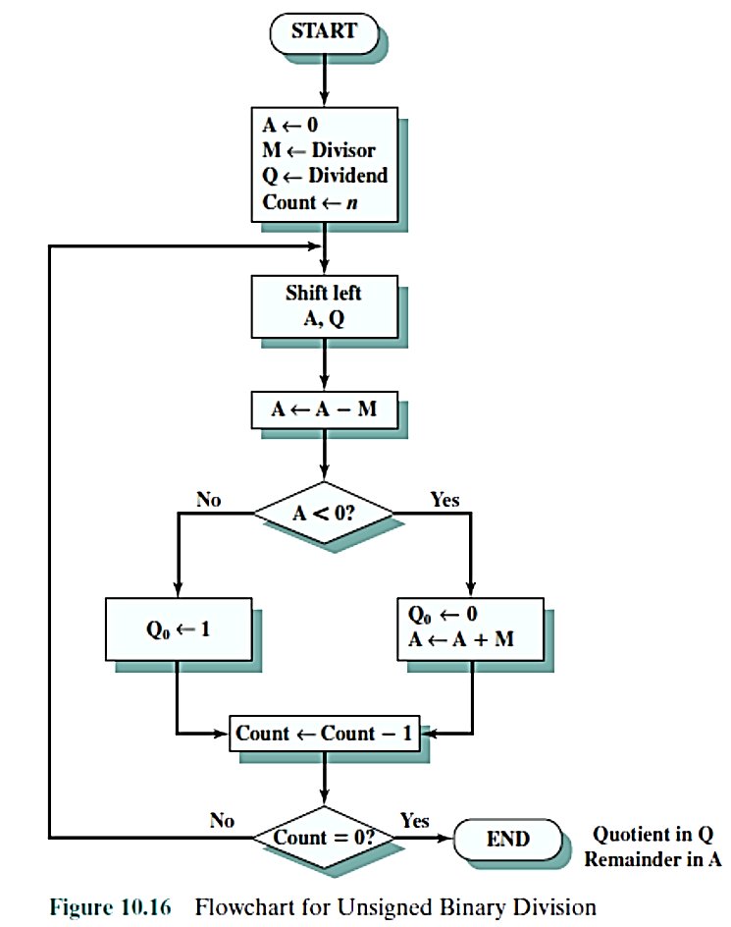
Integer Arithmetic
Division: unsigned integers :

Slide 36
Integer Arithmetic
Division: unsigned integers :
The algorithm assumes that the divisor V and the dividend D are positive and that |V|< |D|. If |V |= |D|, then the quotient Q = 1 and the remainder R = 0. If |V| >|D|, then Q = 0 and R = D. The algorithm can be summarized as follows:
1. Load the twos complement of the divisor into the M register; that is, the M register contains the negative of the divisor. Load the dividend into the A, Q registers. The dividend must be expressed as a 2n-bit positive number. Thus, for example, the 4-bit 0111 becomes 00000111.
2. Shift A, Q left 1 bit position.

Slide 37
Integer Arithmetic
Division: unsigned integers :
3. Perform A = A - M. This operation subtracts the divisor from the contents of A.
4.
a. If the result is nonnegative (most significant bit of A = 0), then set Q0=1.
b. If the result is negative (most significant bit of A = 1), then set Q0=0. and restore the previous value of A.
5. Repeat steps 2 through 4 as many times as there are bit positions in Q.
6. The remainder is in A and the quotient is in Q.

Slide 38
Floating-Point Representation(Homework)
Principles

Slide 39
Amdahl's Law example
int u[10],a,b,c,n,q,z,d,i;
a=b+c;
b=c+a;
q=n+b;
d=q+z;
for(i=0,i<10;i++)
{
u[i]=u[i]+1;
}

Slide 40
Thank you

